Slide 1


Open IE as an Intermediate Structure for Semantic Tasks
Gabriel Stanovsky, Ido Dagan and Mausam

Slide 2
Sentence Level Semantic Application
Sentence
Intermediate Structure
Feature Extraction
Semantic Task
Notes:
We begin by looking at the generic pipeline of semantic applications dealing with sentence level semantics:
This is usually composed of parsing the sentence into some intermediate structure
From which a features can be extracted
And on which the final semantic decision can be made

Slide 3
Example: Sentence Compression
Sentence
Feature Extraction
Semantic Task
Dependency Parse
Notes:
For instance – sentence compression task may begin by getting a dependency representation of the sentence >

Slide 4
Example: Sentence Compression
Sentence
Short Dependency Paths
Semantic Task
Dependency Parse
Notes:
Followed by extracting short dependency path features from it, and then applying sentence compression algorithms based on these features.

Slide 5
Example: Sentence Compression
Sentence
Short Dependency Paths
Sentence Compression
Dependency Parse
Notes:
… and then applying sentence compression algorithms based on these features.

Slide 6
Research Question
Open Information Extraction was developed as an end-goal on itself
…Yet it makes structural decisions
Can Open IE serve as a useful intermediate representation?
Notes:
Our driving research question in this work begins by identifying that even tough Open-IE was developed as an end-goal on itself – mainly to automatically populate large Knowledge Bases
-> It makes certain structural decisions, namely in partitioning the sentence into predicate and arguments, and drawing relations between them, as we will discuss in the next slides
So, we ask -> can Open IE serve as a useful intermediate step in the computation of other semantic representations, like we’ve seen that dependency does, for example, rather than being an end-goal on itself.

Slide 7
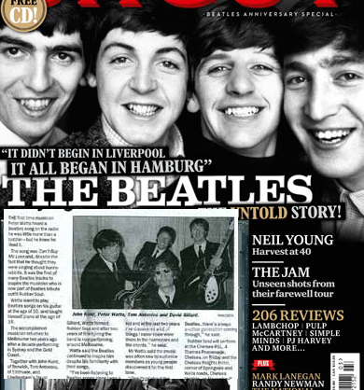
Open Information Extraction
(John, married, Yoko)
(John, wanted to leave, the band)
(The Beatles, broke up)
Notes:
Let’s begin with looking at the original goal of Open IE >
Given a naturally occurring document, Open IE’s goal is to extract a set of coherent, stand alone propositions asserted by the text, so for example, looking at an article on the break up of the Beatles, Open IE might extract that
John married Yoko,
John wanted to leave the band
The Beatles broke up

Slide 8
Open Information Extraction
(John, wanted to leave, the band)
argument
predicate
argument
Notes:
Where each such proposition is an n-ary tuple composed of
a single predicate slot
An arbitrary number of argument slots (2 in this case)

Slide 9
Open IE as Intermediate Representation
Infinitives and multi word predicates
(John, wanted to leave, the band)
(The Beatles, broke up)
Notes:
Alternatively, we would like to look at the properties of Open IE when it comes to the representing predicates and arguments, therefore in the next few slides we will look at some of the decisions Open-IE makes in that respect.
- Predicates are extended in cases of infinitives / multi word expressions

Slide 10
Open IE as Intermediate Representation
Coordinative constructions “John decided to compose and perform solo albums”
(John, decided to compose, solo albums)
(John, decided to perform, solo albums)
Notes:
In cases of coordinative constructions –
Open IE conveniently breaks the sentence into discrete propositions.
So, for the sentence:
“John decided to compose and perform solo albums”
Both
(John, decided to compose, solo albums)
And
(John, decided to perform, solo albums)
Will be extracted.

Slide 11
Open IE as Intermediate Representation
Appositions “Paul McCartney, founder of the Beatles, wasn’t surprised”
(Paul McCartney, wasn’t surprised)
(Paul McCartney, [is] founder of, the Beatles)
Notes:
Finally, if we look at appositive constructions, as in the sentence:
“Paul McCartney, founder of the Beatles, wasn’t surprised”
we get two stand alone propositions:
(Paul McCartney, wasn’t surprised)
(Paul McCartney, [is] founder of, the Beatles)

Slide 12
Open IE as Intermediate Representation
Test Open IE versus:
Notes:
Following these observations, we would like to test how does Open IE fares as an intermediate representation, by testing it against the more common representations:

Slide 13
Open IE as Intermediate Representation
Test Open IE versus:
Bag of words
John wanted to leave the band
Notes:
Bag of words, in which no structure is imposed, but rather just the appearance and order of words is observed

Slide 14
Open IE as Intermediate Representation
Test Open IE versus:
Dependency parsing
wanted
John
leave
to
band
the
Notes:
Dependency parsing –
Which represents the sentence as a syntax trees
>
Predicates are generally single words,
And their arguments are interpreted by looking at subtrees

Slide 15
Open IE as Intermediate Representation
Test Open IE versus:
Semantic Role Labeling
thing wanted
Want 0.1
John
to leave the band
wanter
thing left
Leave 0.1
John
the band
entity leaving
Notes:
And SRL –
Which represents the sentence as a list of unconnected semantic frames, each consisting of a single predicate, and linking it to its semantically typed arguments,
So, for the same sentence we’ll have two semantic frames – “want” and “leave”

Slide 16
Quantitative Analysis
Sentence
Feature Extraction
Semantic Task
Intermediate Structure
Notes:
The way we are going to test
Open-IE vs the other common representations to assess the usefulness of the different decisions it makes.
We choose tasks which make clear separation between feature extraction and following computations.

Slide 17
Quantitative Analysis
Sentence
Feature Extraction
Semantic Task
Intermediate Structure
Notes:
The way we are going to test
Open-IE vs the other common representations to assess the usefulness of the different decisions it makes.
We choose tasks which make clear separation between feature extraction and following computations.

Slide 18
Quantitative Analysis
Sentence
Feature Extraction
Semantic Task
Bag of Words
Notes:
We want to test Open-IE vs the other common representations to assess the usefulness of the different decisions it makes.
We choose tasks which make clear separation between feature extraction and following computations.

Slide 19
Quantitative Analysis
Sentence
Feature Extraction
Semantic Task
Dependencies
Notes:
We want to test Open-IE vs the other common representations to assess the usefulness of the different decisions it makes.
We choose tasks which make clear separation between feature extraction and following computations.

Slide 20
Quantitative Analysis
Sentence
Feature Extraction
Semantic Task
SRL
Notes:
We want to test Open-IE vs the other common representations to assess the usefulness of the different decisions it makes.
We choose tasks which make clear separation between feature extraction and following computations.

Slide 21
Quantitative Analysis
Sentence
Feature Extraction
Semantic Task
Open IE
Notes:
We want to test Open-IE vs the other common representations to assess the usefulness of the different decisions it makes.
We choose tasks which make clear separation between feature extraction and following computations.

Slide 22
Textual Similarity
Domain Similarity
Carpenter ←→ hammer [Domain similarity]
Various test sets:
Bruni (2012), Luong (2013), Radinsky (2011), and ws353 (Finkelstein et al., 2001)
~5.5K instances
Functional Simlarity
Carpenter ←→ Shoemaker [Functional similarity]
Dedicated test set:
Simlex999 (Hill et al, 2014)
~1K instances
Notes:
So the first task we will cover is textual similarity in which we need to asses the degree of similarity between two words, and these come in two flavors –
For domain similarity carpenter will be related to hammer, and other words related to that professions,
While in functional similarity carpenter will be similar to other professions, such as shoemaker

Slide 23
Word Analogies
(man : king), (woman : ?)
Notes:
Another related task is that of word analogy, in which we are faced with three words, and we need to predict the fourth one, which should adhere to the same relation as the first two words.
So, for instance, man is to king as woman is to >
Queen

Slide 24
Word Analogies
(man : king), (woman : queen)
Notes:
queen

Slide 25
Word Analogies
(man : king), (woman : queen)
(Athens : Greece), (Cairo : ?)
Notes:
And similarly, Athens is to Greece as Cairo is to >

Slide 26
Word Analogies
(man : king), (woman : queen)
(Athens : Greece), (Cairo : Egypt)
Notes:
Egypt

Slide 27
Word Analogies
(man : king), (woman : queen)
(Athens : Greece), (Cairo : Egypt)
Test sets:
Google (~195K instances)
MSR (~8K instances)
Notes:
Egypt

Slide 28
Reading Comprehension
MCTest, (Richardson et. al., 2013)
Details in the paper!

Slide 29
Textual Similarity and Analogies
Previous approaches used distance metrics over word embedding:
(Mikolov et al, 2013) - lexical contexts
(Levy and Goldberg, 2014) - syntactic contexts
We compute embeddings for Open IE and SRL contexts
Using the same training data for all embeddings (1.5B tokens Wikipedia dump)
Notes:
Using a 1.5B tokens Wikipedia dump, and state of the art parsers
In the next slides we will show the differences in computing embeddings for each of these

Slide 30
Computing Embeddings
Lexical contexts (for word leave)
John
wanted
to
Word2Vec
leave
the
band
(Mikolov et al., 2013)
Notes:
For the next slides we will treat word2vec as a black box, and focus on the types of contexts which are used to compute a single target word – leave
The original training was done with lexical contexts, so for instance, these are the words which will be fed with a ssliding window of 2 as contexts of the word leave.

Slide 31
Computing Embeddings
Syntactic contexts (for word leave)
John
wanted_xcomp’
to_aux
Word2Vec
leave
the
band_dobj
(Levy and Goldberg, 2014)
Notes:
When computing syntactic embeddings, we will take only words which stand in some dependency relation with the word leave, along with their syntactic relation, so for instance, having “band” as object will be different than having the same word in subject position.
(this was done by Levy and Goldberg)

Slide 32
Computing Embeddings
Syntactic contexts (for word leave)
John
wanted_xcomp’
to_aux
Word2Vec
leave
the
band_dobj
(Levy and Goldberg, 2014)
A context is formed of word + syntactic relation
Notes:
When computing syntactic embeddings, we will take only words which stand in some dependency relation with the word leave, along with their syntactic relation, so for instance, having “band” as object will be different than having the same word in subject position.
(this was done by Levy and Goldberg)

Slide 33
Computing Embeddings
SRL contexts (for word leave)
John_arg0
wanted
to
Word2Vec
leave
the_arg1
band_arg1
Available at author’s website
Notes:
When computing SRL (which is new in this work), we take words that serve as semantic arguments (again, along with their argument type), and might farther than the target word, see “John” in this case.

Slide 34
Computing Embeddings
(John, wanted to leave, the band)
Open IE contexts (for word leave)
John_arg0
wanted_pred
to_pred
Word2Vec
leave
the_arg1
band_arg1
Available at author’s website
Notes:
Finally, when computing Open IE embeddings,
Looking at the word leave again, we will take all the words appearing in the same Open IE frame (all the words of the sentence in this case), and attach the slot index to each word, so John comes from the first argument, while “the” and “band” come from the second.

Slide 35
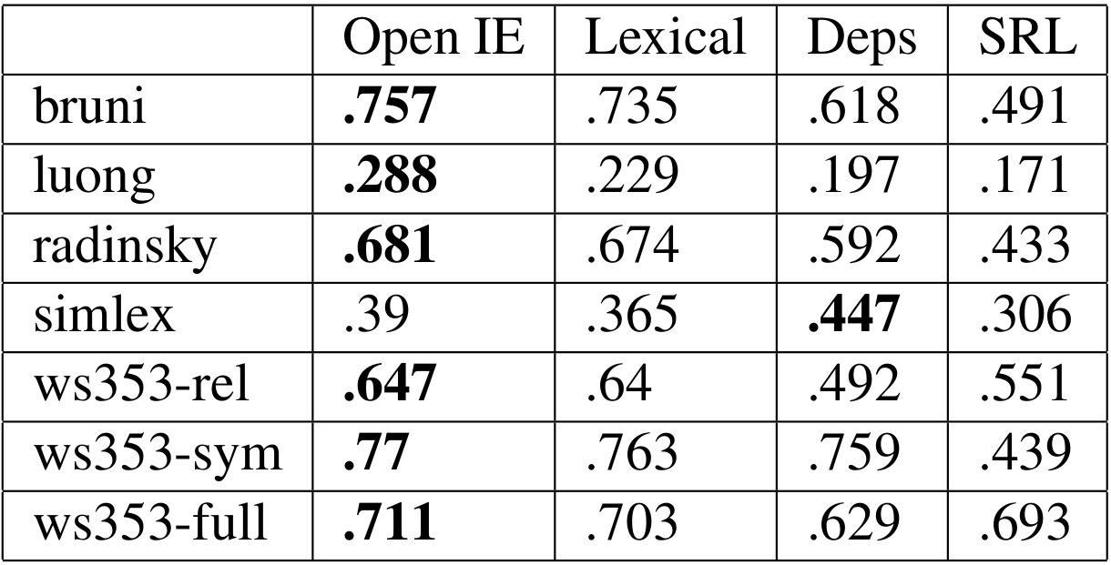
Results on Textual Similarity
Notes:
Given these embeddings, we can compute performance based on similarity metric in this domain.
Interestingly enough, we can see that Open IE consistently does well across all data sets

Slide 36
Results on Textual Similarity
Syntactic does better
on functional similarity
Notes:
Given these embeddings, we can compute performance based on similarity metric in this domain.
Interestingly enough, we can see that Open IE consistently does well across all data sets

Slide 37
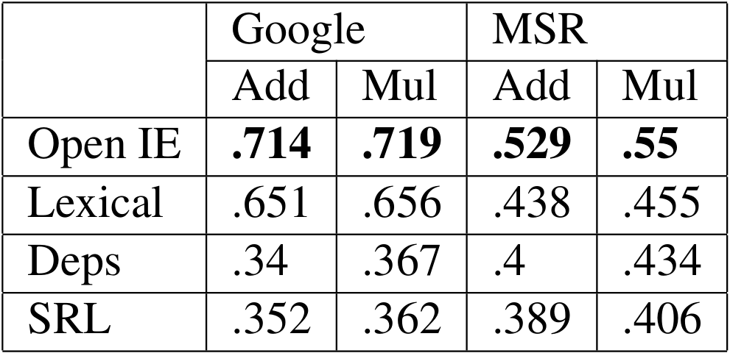


Results on Analogies
Additive
Multiplicative
Notes:
In analogy, the trend continues, and these numbers are the best that we know of for these tasks, and this amount of training data.

Slide 38
Results on Analogies
State of the art with this amount of data
Additive
Multiplicative
Notes:
In analogy, the trend continues, and these numbers are the best that we know of for these tasks, and this amount of training data.

Slide 39
Domain vs. Functional Similarity
Previous work has identified that:
Lexical contexts induce domain similarity
Syntactic contexts induce functional similarity
What kind of similarity does Open IE induce?
Notes:
Analyzing the results iterates previous findings – that lexical embeddings are good for domain similarity, and syntactic embeddings are good for topical similarity.
But what kind of similarity does Open IE produce?
And why does it do so well?

Slide 40
Computing Embeddings
Open IE contexts (for word leave)
Long range
Functional similarity
John_arg0
wanted_pred
Lexically close
Domain similarity
to_pred
Word2Vec
leave
the_arg1
Long range
Functional similarity
band_arg1
Open IE combines domain and functional similarity in a single framework!
Notes:
Looking again at the contexts, we see that long range topical words are introduced from other slots, while closer, domain similar words are drawn together based on words from the same slot.
-> this yields that Open IE better captures both types of similarity!

Slide 41
Concluding Example
(gentlest: gentler), (loudest:?)
Lexical: higher-pitched
Syntactic: thinnest
SRL: unbelievable
Open-IE: louder
X
[Domain Similar]
X
[Functionally Similar]
X
[Functionally Similar?]
V
Notes:
Let’s see an example of this, from the analogy corpus.

Slide 42
Conclusions
Open IE makes different structural decisions
These can prove beneficial in certain tasks
A key strength is Open IE’s ability to balance lexical proximity with long range dependencies in a single representation
Embeddings made available: www.cs.bgu.ac.il/~gabriels
Thank you!
Questions?

Slide 43
Why does Open IE do better?
Captures domain and functional similarity
latinist ←→ classicist
provincialism ←→ narrow-mindedness
vindictively←→ malicious
Notes:
Balances lexical proximity with long range dependencies:

Slide 44
Reading Comprehension
MCTest, (Richardson et. al., 2013)
Once upon a time, there was a cowgirl named Clementine. Orange was her favorite color. Her favorite food was the strawberry. She really liked her Blackberry phone, which allowed her to call her friends and family when out on the range. One day Clementine thought she needed a new pair of boots, so she went to the mall. Before Clementine went inside the mall, she smoked a cigarette. Then she got a new pair of boots. She couldn't choose between brown and red. Finally she chose red, which the seller really liked. Once she got home, she found that her red boots didn't match her blue cowgirl clothes, so she knew she needed to return them. She traded them for a brown pair. While she was there, she also bought a pretzel from Auntie Anne's.
What was the cowgirl's name?
*A) Clementine
B) Blackberry
C) Strawberry
D) Orange
Notes:
MC500 setting 2K multiple choice questions based on 500 short stories

Slide 45
Reading Comprehension
MCTest, (Richardson et. al., 2013)
Once upon a time there was a cowgirl named Clementine.
Orange was her favorite color. Her favorite food was the strawberry. She really liked her Blackberry phone, which allowed her to call her friends and family when out on the range. One day Clementine thought she needed a new pair of boots, so she went to the mall. Before Clementine went inside the mall, she smoked a cigarette. Then she got a new pair of boots. She couldn't choose between brown and red. Finally she chose red, which the seller really liked. Once she got home, she found that her red boots didn't match her blue cowgirl clothes, so she knew she needed to return them. She traded them for a brown pair. While she was there, she also bought a pretzel from Auntie Anne's.
What was the cowgirl's name?
*A) Clementine
B) Blackberry
C) Strawberry
D) Orange
Notes:
MC500 setting 2K multiple choice questions based on 500 short stories

Slide 46
Reading Comprehension
MCTest paper uses lexical matching
Once upon a time The young boy from Texas refused to visit a casino in Las Vegas.
Orange was her favorite color. Her favorite food was the strawberry. She really liked her Blackberry phone, which allowed her to call her friends and family when out on the range. One day Clementine thought she needed a new pair of boots, so she went to the mall. Before Clementine went inside the mall, she smoked a cigarette. Then she got a new pair of boots. She couldn't choose between brown and red. Finally she chose red, which the seller really liked. Once she got home, she found that her red boots didn't match her blue cowgirl clothes, so she knew she needed to return them. She traded them for a brown pair. While she was there, she also bought a pretzel from Auntie Anne's.
The young boy from Texas visited a casino in Las Vegas ?
Lexical score of 20/24
Notes:
Simplified version of the

Slide 47
Reading Comprehension
We generalize to representation units matching
(The young boy from Texas, refused to visit, a casino in Las Vegas)
(The young boy from Texas, visited, a casino in Las Vegas)
Open IE scores 2/3

Slide 48
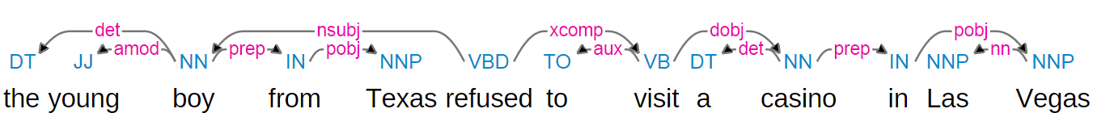
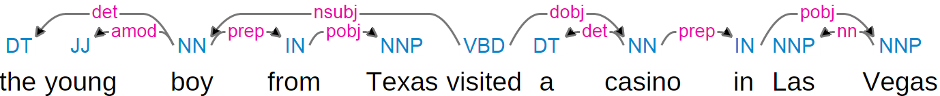
Reading Comprehension
MCTest paper uses lexical matching, we generalize to representation units matching
Dependencies scores 9/11

Slide 49
Reading Comprehension
MCTest paper uses lexical matching, we generalize to representation units matching
Refused_0.1: (A0:The young boy from Texas, A1:to visit a casino in Las Vegas)
Visit_0.1: (A0:The young boy from Texas, A1: a casino in Las Vegas)
Visit_0.1: (A0: The young boy from Texas, A1: a casino in Las Vegas)
SRL scores 4/6

Slide 50
Reading Comprehension
Notes:
Results are split between:
“single” – for which a single sentence from the story suffices to answer a question
“multiple” – multiple sentences from the story are needed
Random guess should do around 25%

Slide 51
Reading Comprehension
Better abstraction:
VS. lexical and dependencies: Better abstraction level
VS. SRL: Combines separated frames into larger, more coherent ones
Notes:
Random guess should do around 25%

